Slide 1

HR Analytics Employee Attrition Analytics
Reshma.Prajapati
Trupti.Nadivadekar
Aditee
Shailesh

Slide 2
AGENDA
Objective
What is HR Analytics
Why we are doing HR Analytics
Data Cleaning
Exploratory Data Analysis
Predicting Attrition of Employees
Machine Learning
Decision Tree
Random Forest
Logistic Regression
KNN
Recommendations
Conclusion

Slide 3
Business objective
Source
To build a data model to predict the following:
Identify factors influencing attrition.
Predict possible attritions
Identify possible ways to retain high performers
2 Dataset containing complete staff utilization reports for all employees of the XYZ Corp. through 2016-2018.
Each dataset contains 115 columns and ~900 rows.
Other file contains all the attrition in the organization for the years 2016-18 with details such as reason of attrition, age and gender.

Slide 4
What is HR Analytics & why?
What
It allows HR professionals and management to use a data-driven approach to make better business decisions that improve companies’ performance.
Why
To provide insight into how best to manage employees and reach business goals. Because so much data is available, it is important for HR teams to first identify which data is most relevant, along with how to use it for maximum ROI.
Ex.
Microsoft
Over the years, Microsoft has been going through a sort of evolution in HR analytics,Today where they focus on data-driven HR as a best practice within their company.By focusing their approach on the parts of the business with particularly high turnover rates, Microsoft was able to reduce attrition
rates by more than half in each instance and eventually adapt the same tactics to the other areas of business, improving overall employee
experience and organisational processes.
`

Slide 5
Data Cleaning
Out of 115 columns,we decided to drop the columns containing monthly data.
Columns namely : Total work hours, Total Training hours, Total BD hours and Total NC hours have shown record in the range of ~2 hrs to ~2400 hrs per year. What does this mean?
Where the record shows lowest Total work hours there are higher Total Training hours, Total BD hours and Total NC hours; and vice versa.
Total missing counts: Employee Position - 09 in 2017-2018 dataset
Replaced by Mode : Level 7 (New Joiners)
Total work hours, Total Training hours, Total BD hours and Total NC hours which have shown record 00 and Negative (-ve) values : 11 rows
Data Removed from both datasets.

Slide 6
EDA
Addition of column namely : No. of years in organization.(Calculated)
Target variable is named as Final Status where 1:Active, 0:Terminated.
We decide to go ahead with Profit Center ,Employee Position, Employee Location, People Group, Total Work Hours, Total Leave Hours, Total Training Hours, Total BD Hours, Total NC Hours, No Years InOrg.
Rate Attrition :
Year | 2016-17 | 2017-18
Sample Size | 783 | 968
Active | 644 | 828
Terminated | 139 | 140
Attrition Rate | 18% | 14%

Slide 7
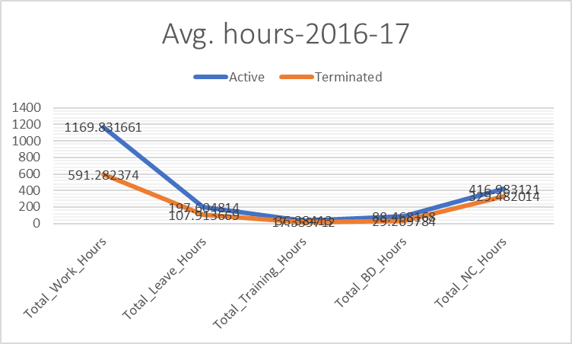
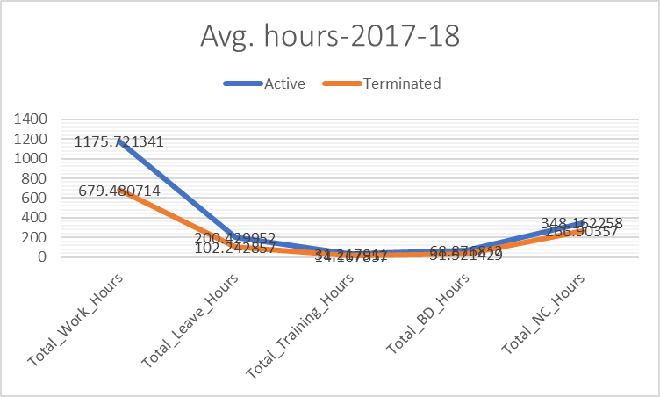
EDA & VISUALIZATION

Slide 8
Machine Learning 2016-17 Dataset
Logistic Regression
KNN Model
Random Forest
Decision Tree
Test - Accuracy
0.85
Train - Accuracy
0.85
Test - Accuracy
0.85
Train - Accuracy
0.86
Test - Accuracy
0.90
Train - Accuracy
1.00
Test - Accuracy
0.88
Train - Accuracy
0.87
Machine Learning 2017-18 Dataset
Logistic Regression
KNN Model
Random Forest
Decision Tree
Test - Accuracy
0.88
Train - Accuracy
0.87
Test - Accuracy
0.86
Train - Accuracy
0.87
Test - Accuracy
0.90
Train - Accuracy
1.00
Test - Accuracy
0.88
Train - Accuracy
0.89

Slide 9
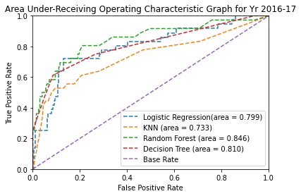
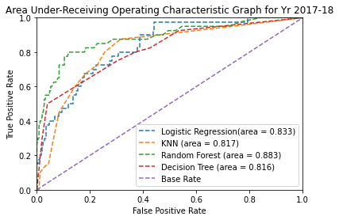
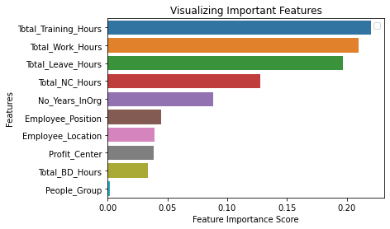
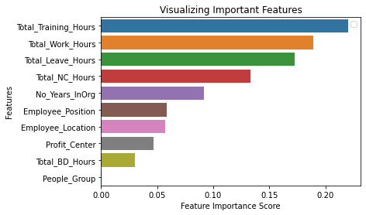
AUC-ROC Curve & imp. features

Slide 10
Conclusion & Inference
Why Random Forest?
In Random Forest, we can plot multiple trees that learn from one another's mistake (or wrong prediction) to give a better accuracy.
From ROC curve we can identify that Random Forest has highest accuracy.
So we move ahead with Random Forest which also gave Feature importance graph based on which we can predict factors influencing attrition.
Total Working and Training Hours are the primary factors influencing attrition in both the years.
Leave Hours and NC Hours are the secondary factors influencing attrition in both the years.
Employees that resign with the least no of working year belong to the age group of 26 to 30.

Slide 11
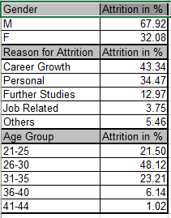
Conclusion & Recommendation
Future Prediction
Model prediction of data of 2016-17 is giving 15% attrition for the following year.
Model prediction of data of 2017-18 is giving 13.75% attrition for the following year.
Employees resigning are falling in the age group of 21 to 30 which is ~70% of the attrited employee data and are also falling at lower job levels of which majority are male.
We recommend to provide considerably high training hours to Employee Position : 6,7,8 and Employee Location : 1,3,7, as they are showing high attrition in the previous years
We can retain high performers by providing them high training hours which may also give them internal career growth.

Slide 12

“Research indicates that employees have three prime needs: Interesting work, recognition for doing a good job, and being let in on things that are going on in the company.”
Zig Ziglar
Thank You

